Slide 1




















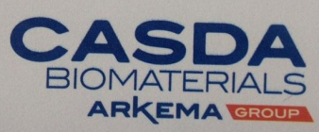












































Working for over 80 global players for more than 17 years
Your contacts stephanie.lorini@dynovel.com
justin.shemonsky@dynovel.com
Time to boost your business
2017
From Research to Turnover
Dynovel Inc.
33 Rock Hill Road
Bala Cynwyd, PA 19004
USA
Your contact in Europe
jean-pierre.molitor@daydream.eu
nicolas.messin@daydream.eu
Your contact in Asia
Yusi.chen@daydream.eu
Europe
Daydream GmbH
Kaiser Wilhelm Ring, 13
50672 Cologne, Germany
Asia
Daydream BC(Shanghai) Ltd.
Tianmu West Road,
Zhabei, Shanghai, 200.070, China
www.daydream.eu; contact@daydream.eu
Dynovel Exclusive partner of Daydream

Slide 2

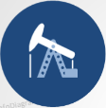
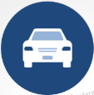
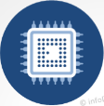
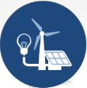

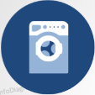
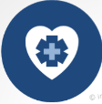
“Since 2000, Daydream has performed projects across a vast range of Specialty Chemicals along the Home & Personal Care value chain (ingredients producers, formulators, Brand makers, end-users) for leading chemical companies”.
B to B Market Strategy to NBD
People and Tools
Formulators
Active Principles
Packaging
Fine powders
Cosmetics
Flexibility
Beads
Silicones
waterborne
Marine
No matter if you are a sales head, marketing director, strategic development director or a general manager of a product portfolio, Daydream will provide you tailor-made consulting services, meeting 100% of your specific needs.
Powder
Biotechnology
CMO
Emulsions
Color
Pharmaceuticals
Private Labels
Polyester
Emollient
Home & Personal Care
Waterborne
Skin Care
Market & Business Strategy
New Business Development
Excipient
I&I cleaning
of Dynovel’s consultants have bachelors/master/ doctorate degree in science and engineering.
of your objectives met thanks to our systematic and proven methodology for project management.
Market understanding
Value proposition definition
Technical requirement definition
Market sizing and Trends
Channel to market definition
Business Plan and Business Strategy creation
Product Launch
Cold Prospecting
Validation of value proposition
Pipeline creation
Trials & samples
90%
100%
Operations Business
of Dynovel’s clients are within Chemical (incl. Bio), Life Sciences, and Materials Industry.
of Dynovel’s conclusions are based on traceable information & validated assumptions.
People Training & Coaching on Market Strategy Creation, NBD
Ideation and differentiation workshop
Best Practice Implementation
80%
100%
People
development
D-Method Tools implementation (AA Matrix,…)
Anaplan APPS for Market Strategy, Pipeline and R&D projects portfolio management
Method & Tools

